Slide 1
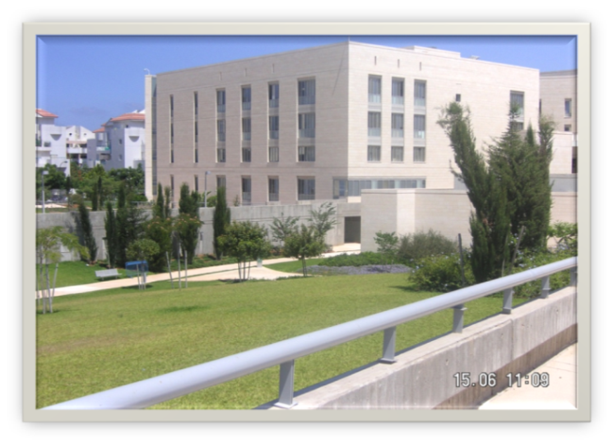
ICT Support for Students in Higher Education
The Open University of Israel
Department of Education and Psychology
Tali Heiman: talihe@openu.ac.il
Dorit Olenik-Shemesh: doritol@openu.ac.il
Dana Kaspi-Tsahor: danakas@openu.ac.il

Slide 2
Accessibility in Higher Education in Israel
2011- An equal rights regulation draft was written which included accessibility adjustments to existing public places, higher education institutions, and to higher education services.
2015 - Israeli Internet regulations (ICC 5568 ) - on the basis of global accessibility guidelines (W3C).
2016 - The regulation of higher education institutions is legislated .
2017- Higher education institutions are required to accessibility adjustments.

Slide 3
The Open University of Israel (OUI)
Uniqueness:
Open admissions.
Distance learning method.
Integration of teaching methods, including technologies.
ICT Model:
User centered design: until 2011, customized accessibility at the request of the student with a disability.
Universal design approach: since 2011, OUI has been undergoing a process of physical accessibility as well as a process of instilling service accessibility regulations.

Slide 4
E-university
Digital learning material
Online teaching
&
learning
Online learning environment
Open to the public
Open courses to the public
Online live video lessons
Online collaborative assignments
Interactive multimedia components
YouTube
Recorded video lessons
Video lectures
Google books
Tuition fees
Online assignment system
Virtual library
Registration
Online administration Services
E-books, audio books
Online personal schedule
Finding, developing, experimenting, assimilating, evaluating and assessing new technologies and methods.

Slide 5
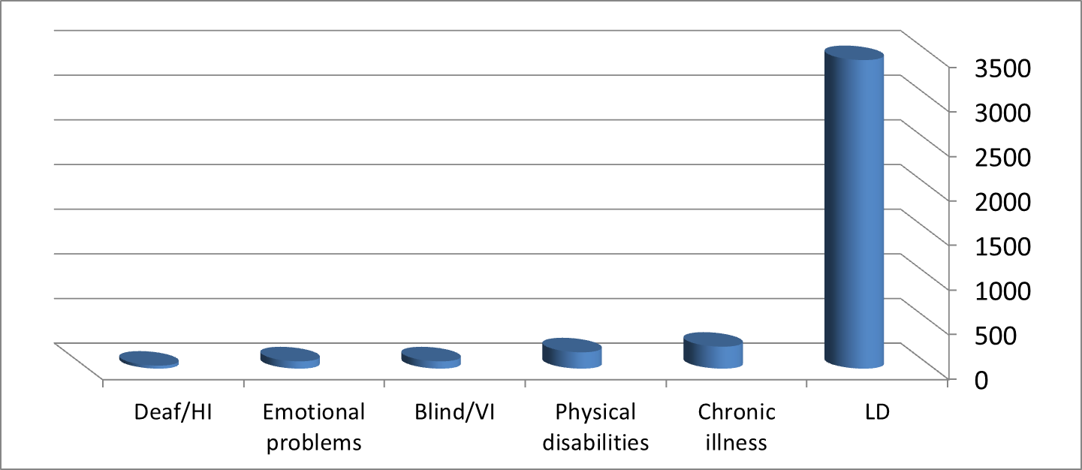
Students with Disabilities at OUI
(1st semester 2017, n = 4002)
3455
246
34
82
82
183
Support assistance
Assistive ICT technology tools (e.g., speech synthesis).
Face-to-face assistance: personal or in small groups - skills training, specific subject tutoring, additional guidance.
Virtual Internet assistance.

Slide 6
ICT Tools at the OUI
The varieties of ICT tools used by tutors at the OUI:
Online course materials.
Online tools (collaborative online work)
Hardware (e.g., SMART board).
Communication tools (e.g., chat room and email).
Social networking (e.g., blogs, Facebook, Twitter).
Computer technologies used in class (simulations and presentation/ spelling checkers, dictionaries, and English Text-To-Speech (TTS) Software).

Slide 7
Implementations of the ICT
The administrative staff has undergone practical training.
The academic staff is undergoing training on making academic studies accessible.
Challenges in implementing ICTs
Lack of technologies which support Hebrew language.
Lack of training and difficulty obtaining services.
A need to improve the accessibility for ICT resources.
ICT support is very expensive.
Disagreements among students without disabilities (slow studying; lower achievements; conflicts of interests regarding the different needs).

