Slide 1
Higher Ed Accessible Technology in the U.S.
Dan Comden
danc@uw.edu
UW Information Technology
Accessible Technology Services

Slide 2
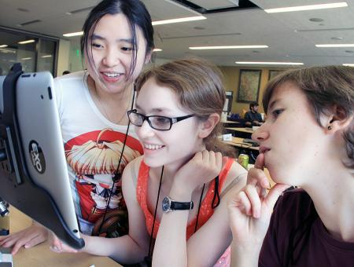
Pre-college
Technology is personalized
So is support
Equipment/software follows the student
Notes:
Academic materials may be acquired from many sources. Some times parents are heavily involved. There is much inconsistency as far as effectiveness and appropriateness of accommodations K-12 viewed nationally.

Slide 3
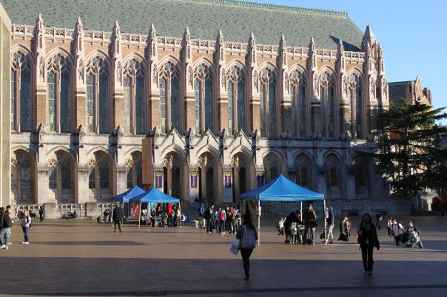
Higher Ed: 3 Approaches
Support for ICT can come from 3 homes:
Student Services
Information Technology
Some combination of above
Notes:
Support for students changes dramatically once they have completed K-12 schooling.
Services must be initiated by the students and they are responsible for initiating and maintaining the arrangements throughout their college career.
Just as in the K-12 system, support for accessibility is not uniformly driven, however this is (slowly) changing with historic actions by DOJ and DoE.
Larger universities can support staff to work proactively while smaller and less-funded schools typically lack resources to test and deploy accessible ICT. They usually rely on the work done at bigger schools.

Slide 4
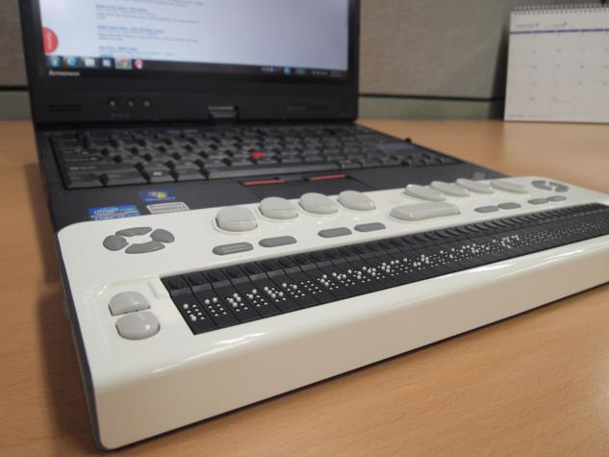
Student Services Approach
Pros:
“One stop shopping”
Personalized experience
Cons:
Weak IT skills + poor IT support
Models: Medical, social, or mixed

Slide 5
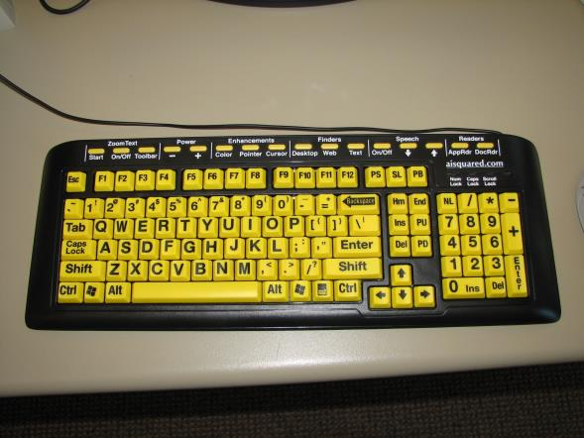
IT Approach
Pros:
Strong IT skills/support
Equivalent access achievable
Cons:
Extra student effort
Training requirements
Framework: Universal design
Notes:
Need to have staff dedicated to AT and accessibility
Easier to do campus-wide rollouts with AT existing on images.
This means SWD don’t go to a “special” location
IT support staff (often students) need training in AT and working with PWD
SWD may need training for their AT – where do they get it?

Slide 6
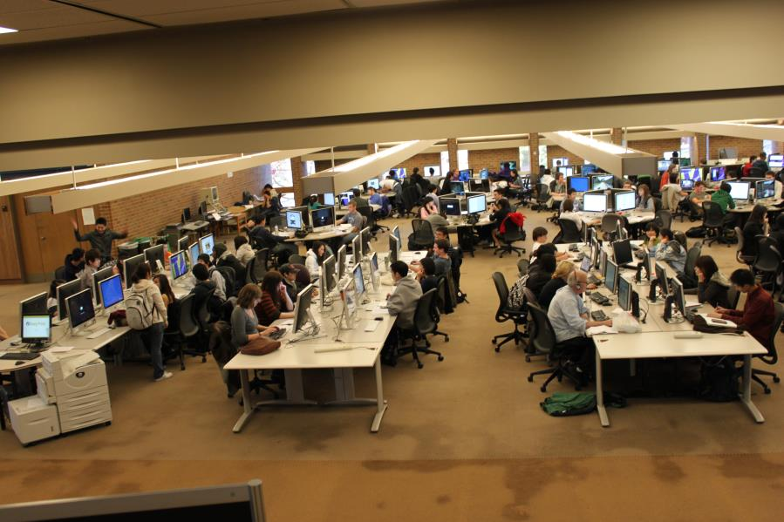
Combo of DS and IT
Consistent service to students
Challenging management (2 bosses)
Very rare
Notes:
This approach can help assure a consistent experience for all students. There is no need to visit a separate office if there is an IT/AT specialist in the DS office.
Very rarely seen – I have only heard of two institutions with this approach in the US.

Slide 7
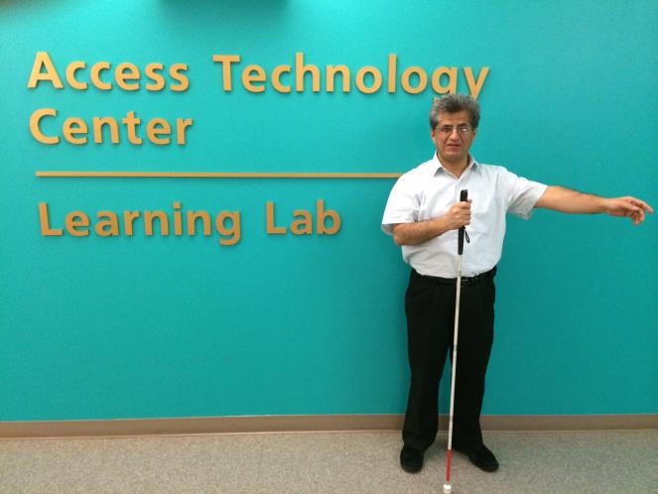
Examples
Basic AT available
Special Requests
Alternative media
Proactive vs. reactive

