Slide 1
Summary & Reflection on Day 1
Aims for Day 2

Slide 2
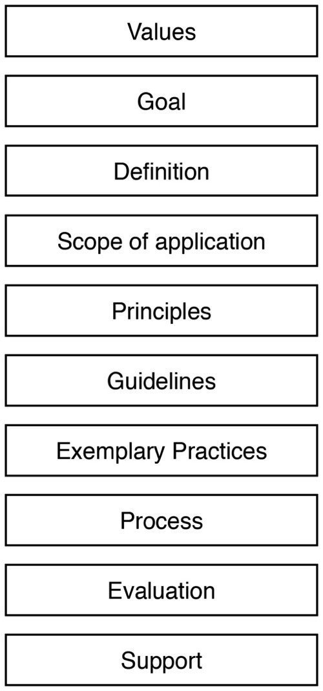
Framework & logic model
• for inclusive [application: teaching, physical spaces, services, or ICT]
• at [institution]:
Values:
Diversity
Social justice
Goals:
Equity
Inclusion
Compliance
Practices:
Training, outreach, … tailored to institution, culture, policies, unit functions
Outputs & Outcomes:
Develop
measures
Produce
reports
Impact:
Equity
Inclusion
Compliance
Approach:
UD, accomm
Definitions
Principles
Guidelines
Processes
Stakeholders
Inputs:
Top-down,
bottom-up
support
Staff
Funding

Slide 3
Participant Panel: Design
What are the design issues regarding ICT with respect to the institution & students with disabilities in post-secondary education?
And, how if at all do models & frameworks contribute to resolving design issues?

Slide 4
Participant Panel: Design
What are the design issues regarding ICT with respect to the institution & students with disabilities in post-secondary education?
And, how if at all do models & frameworks contribute to resolving design issues?

Slide 5
Participant Panel: Transition
What are the ICT issues related to transition to employment for students with disabilities?
And, how if at all do models & frameworks contribute to resolving these issues?

Slide 6
Participant Panel: Students
What are student experiences of how the support & delivery of ICT has impacted learning & transitions between education levels & to employment

Slide 7
Input from students RE issues:
Your school may not provide the assistive technology (AT).
AT prices are high because of low volume in sales.
Often AT does not integrate well with mainstream ICT because they aren't made with each other in mind.
The computers may not have the software that you need.

Slide 8
Input from students RE issues:
Most videos are not captioned.
Images, PDFs, websites are often not accessible.
Accessibility should be an important component for all ICT, not tacked on at the end as an afterthought or a “feature.”

Slide 9
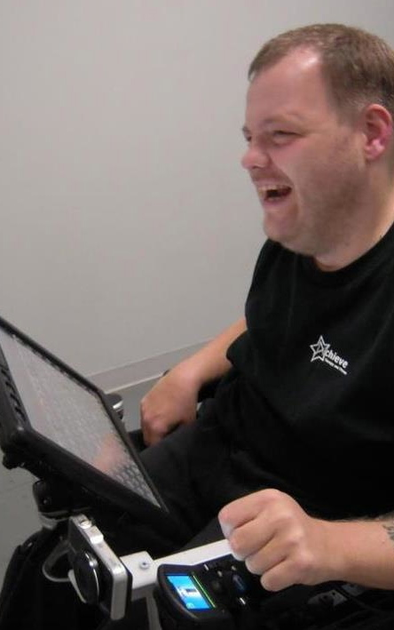
Anthony
AT Specialist
Prentke Romich Co.
grammar/spell checkers
synthesized voice on communication device
touch screen
computer-based environmental control, phone access

Slide 10
Anthony:
        “…assistive & mainstream technology companies need to work together in order for people with disabilities to get better results with their products.“
        “…we need to continue
        to prepare future
        developers on
        accessibility issues.”

Slide 11
World Café

Slide 12

Q&A, Discussion

