Slide 1

How design frameworks and models have informed my work
Sheryl Burgstahler, Director
Accessible Technology Services
University of Washington

Slide 2


Two UW centers:
        Access Technology Center (ATC)
          Founded 1984
          Funded by UW for faculty, students, staff
          DO-IT Center
          Founded 1992
          Supported with federal, state,
          corporate, private funds
          Expanded to DO-IT Japan, 2007
          & DO-IT Singapore 2016

Slide 3




Examples of DOT-IT projects
The Center on UD in Education

Slide 4

Universal Design in Higher Education:
From Principles to Practice
second edition, 2015
Harvard Education Press
more than 40 authors/
co-authors
Includes multiple stakeholder perspectives, including students with disabilities, practitioners

Slide 5
UD can be viewed as an attitude, a framework, a goal, & a process
UD values diversity, equity, & inclusion
UD promotes best practices & does not lower standards
UD is proactive & can be implemented incrementally
UD practices are designed be adaptable, benefit everyone, minimize the need for accommodations

Slide 6

Apply UD to create inclusive:
physical spaces
instruction
services
information & communication technology (ICT)

Slide 7
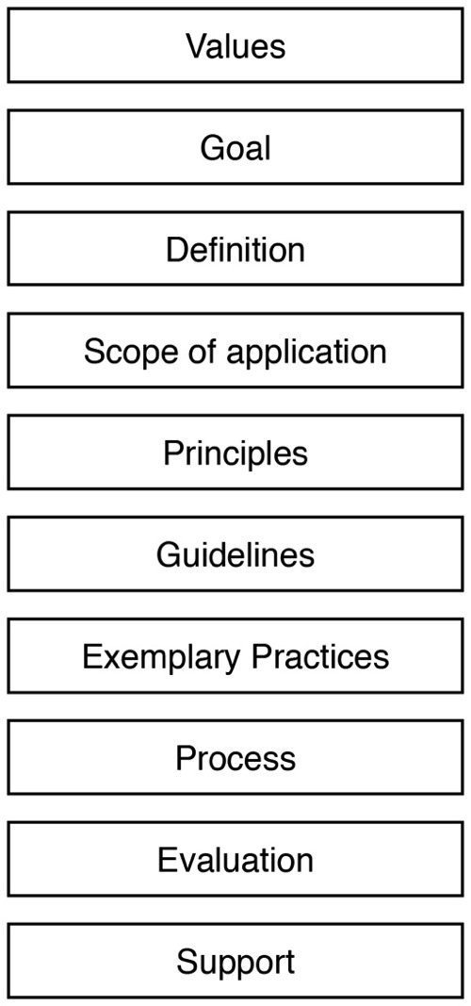
Aspects of a UD framework

Slide 8
Values:
social justice model of disability
diversity, equity, inclusion
e.g., UW specific values of diversity, excellence, collaboration, innovation, & respect

Slide 9
Goals:
to educate a diverse student body
to support an inclusive culture
to comply with legislation

Slide 10
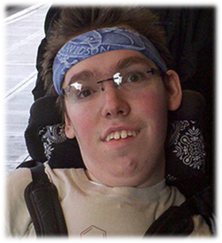
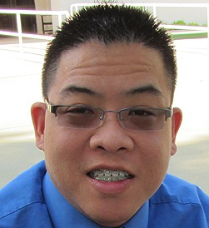
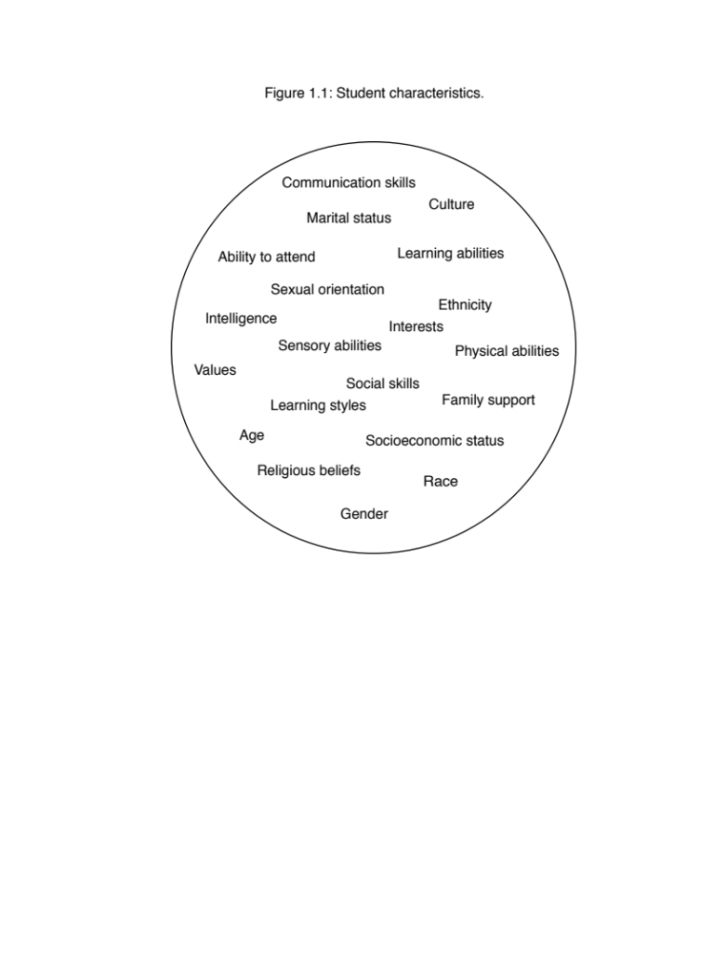

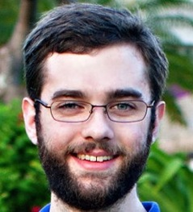
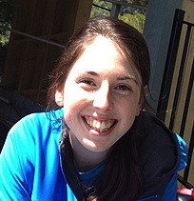
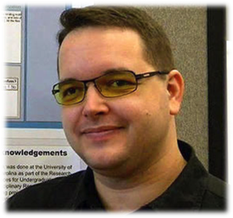
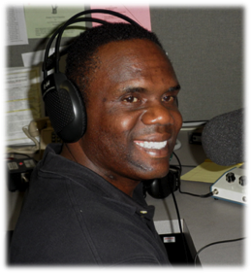
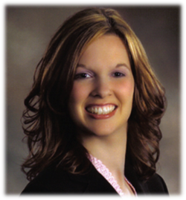
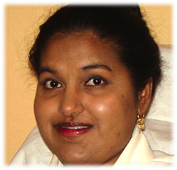
Consider ability/disability as part of diversity:

Slide 11
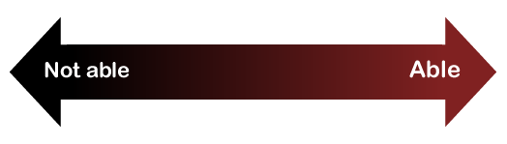
Consider ability on a continuum
see
hear
walk
read print
write
communicate verbally
tune out distraction
learn
manage physical/mental health

Slide 12
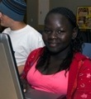
Differences in
US education legislation
K-12: Every child is offered a free, appropriate education in as integrated setting as possible
Post-secondary: Students must meet the entrance/course/graduation requirements with our without reasonable accommodations that they must request

Slide 13

So who pays for ICT for students?
During school, the institution
  K-12: Whatever they need
  Post-secondary: What they provide to other students
At home, family,
social services,
charities (e.g.,
DO-IT)

Slide 14
Definitions:
accommodations
universal design (UD)

Slide 15

Most common IT accommodations at UW:
Creating accessible documents, mainly reformatting PDF files—20,000 pages average each quarter 2014-16
Captioning videos
—191 hours costing
$34,341 Fall, 2016

Slide 16
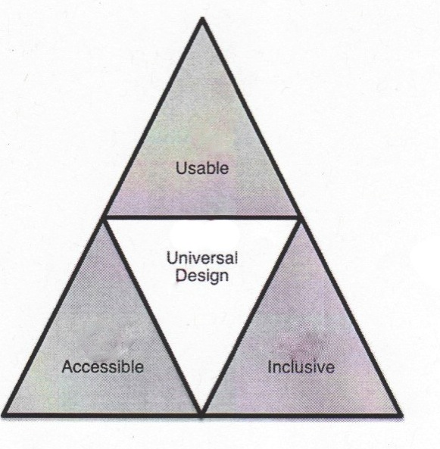
Universal design =
“the design of products & environments to be usable by all people, to the greatest extent possible, without the need for adaptation or specialized design.”
The Center for Universal Design www.design.ncsu.edu/cud

Slide 17
Proactive approaches to access
universal design
inclusive design
barrier-free design
accessible design
usable design
design for all
others???

Slide 18
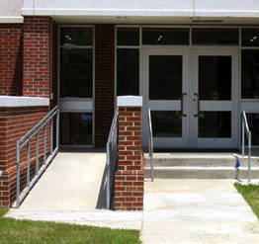
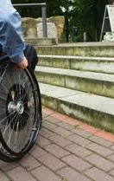
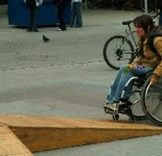
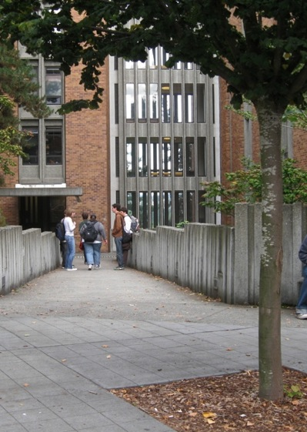
UD provides inclusive access
UD

Slide 19
Scope of ICT
UD application
all mainstream ICT
assistive technology (AT)

Slide 20

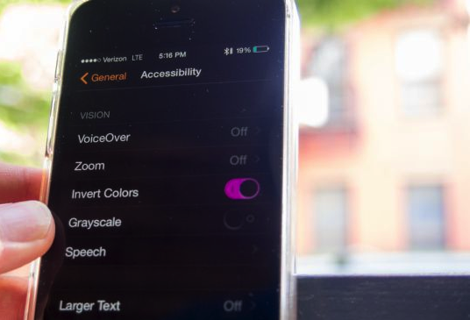
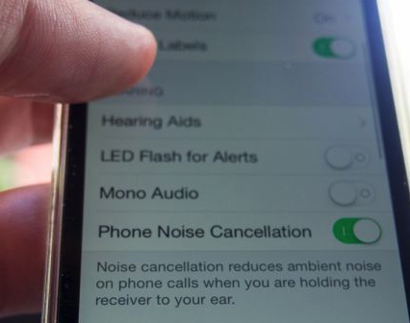

UD of ICT
builds in accessibility features
ensures compatibility with assistive technology

Slide 21
Addressing the Needs of AT Users: Data Table
Assistive technology: | Therefore:
Emulates the keyboard, but may not emulate the mouse | Design web, software to operate with keyboard alone
Cannot read content presented in images | Provide alternative text
Can tab from link to link | Make links descriptive
Can skip from heading to heading | Structure with hierarchical headings
Cannot accurately transcribe audio | Caption video, transcribe audio

Slide 22
UD principles
Equitable use
Flexibility in use
Simple & intuitive use
Perceptive information
Tolerance for error
Low physical effort
Size & space for approach & use

Slide 23
UD guidelines for ICT:
WCAG 2.0
2015 EDUCAUSE report “IT Accessibility Risk Statements & Evidence”
Tailor assistive technology (AT) to individual needs

Slide 24
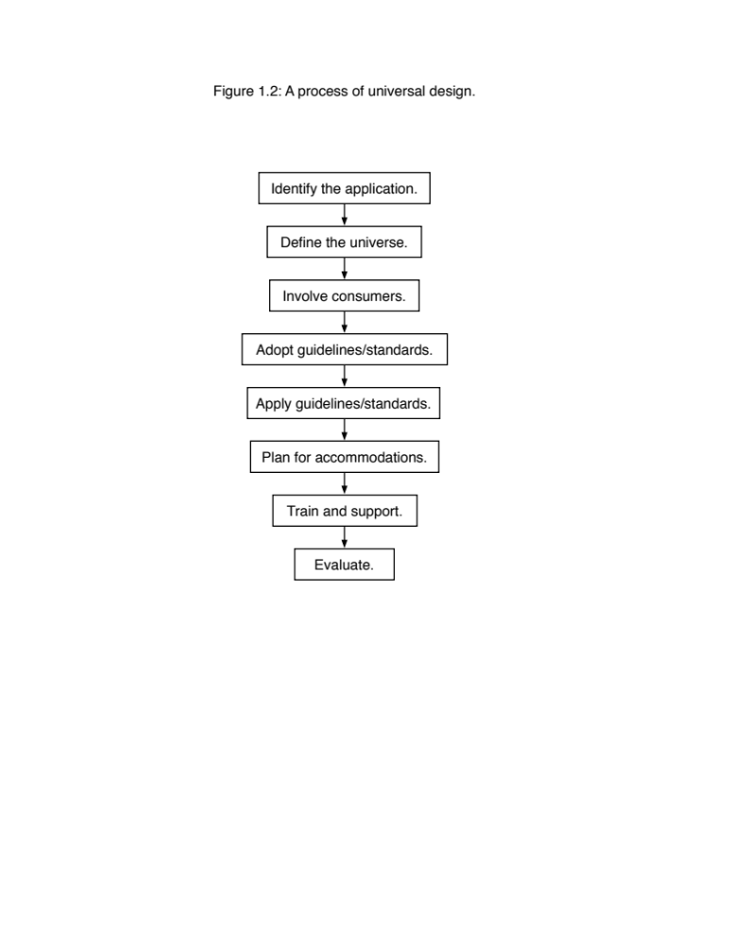

UD process:

Slide 25
Exemplary practices
Promote accessibility within context of UD, social justice/civil rights & inclusive campus culture
Build on current policies & procedures
Undertake efforts that are
  Both reactive & proactive;
  Both top-down & bottom-up
Charge a campus-wide IT Accessibility Task Force & enlist IT Accessibility Liaisons
Develop IT accessibility policy, guidelines, checklist, procedures

Slide 26
Evaluation
Determine how to measure progress toward improved ICT access & use
Conduct annual reports

Slide 27
Support
Offer training, consultation
Support user groups
Proactively test websites, PDFs & help remediate
Offer incentives (free video captioning & PDF remediation pilots; Lynda courses)

Slide 28
Research on UD
UD of ICT: Usability testing design approach
CAST, UDL: Builds on education research, but most applied at elementary level & in language arts, & innovations not tested with students with wide variety of characteristics
Of 19 studies in UDI research review in UDHE book, 3 used experimental or quasi-experimental design & most looked at average success/satisfaction of students overall
DO-IT 2x2 quasi-experimental design showed that post-secondary students with disabilities in classes with UDI-trained instructor received grades closer to those of students without disabilities

Slide 29
What ICT design should be addressed with UD; what should be addressed with AT & other accommodations?
UD of ICT
+
AT & other accommo-dations
=
= ICT that supports student success

Slide 30
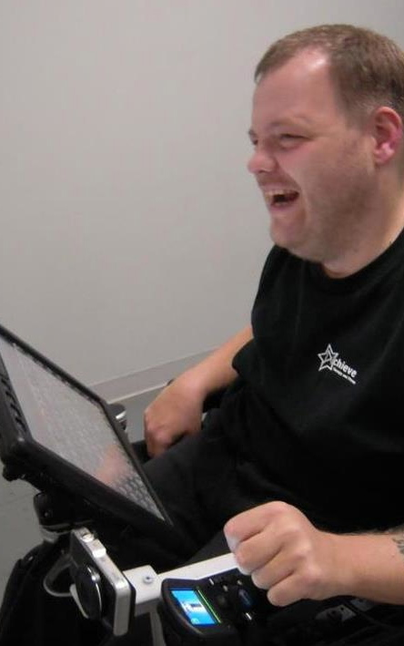
Anthony
AT Specialist
Prentke Romich Co.
grammar/spell checkers
synthesized voice on communication device
touch screen
computer-based environmental control, phone access

Slide 31
Anthony:
        “…assistive & mainstream technology companies need to work together in order for people with disabilities to get better results with their products.“
        “…we need to continue
        to prepare future
        developers on
        accessibility issues.”

Slide 32
Feedback from students RE issues:
(1 of 2)
Your school may not provide the assistive technology (AT).
AT prices are high because of low volume in sales.
Often AT does not integrate well with mainstream ICT because they aren't made with each other in mind.
The computers may not have the software that you need.

Slide 33
Feedback from students RE issues:
(2 of 2)
Most videos are not captioned.
Images & PDFs may not be accessible.
I find that websites are often not accessible.
Accessibility should be an important component for all ICT, not tacked on at the end as an afterthought or a “feature.”

Slide 34

Q&A, Discussion

