Slide 1





The Road to ICTs is Paved with Good Intentions
Alice Havel, Catherine Fichten, Laura King,
Mary Jorgensen
1st Ed-ICT International Network Symposium, Seattle, Washington
March 14, 2017

Slide 2
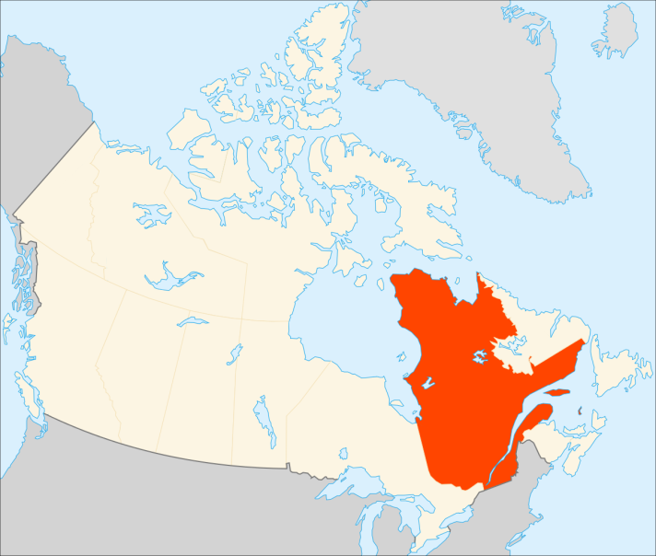
A Quebec Perspective
Post-secondary education, a provincial responsibility
Quebec Charter of Human Rights and Freedoms
Distinct society
  Language
  Religion

Slide 3
Quebec Charter of Human Rights and Freedoms
“Every person has a right to full and equal recognition and exercise of his human rights and freedoms, without distinction, exclusion or preference based on … a handicap or the use of any means to palliate a handicap”

Slide 4
Models Used in Quebec
Medical
Social
Disability Creation Process
Interactional
Universal Design for Learning
Notes:
Alt text will read: The medical model and the social model can be integrated to result in an interactional model. One example of an interactional model is the Disability Creation Process model that was developed and is used in Quebec. The theoretical framework of the social model has led to the development of the Universal Design for Learning (UDL) model.

Slide 5
Disability Creation Process
Risk Factors
Cause
Personal Factors
Environmental Factors
Organic Systems
Capabilities
Integrity Impairment
Ability Disability
Facilitator Obstacle
Interaction
Life Habits
Social Participation Handicap Situation
Copyright INDC P/CSICIDH 1998

Slide 6
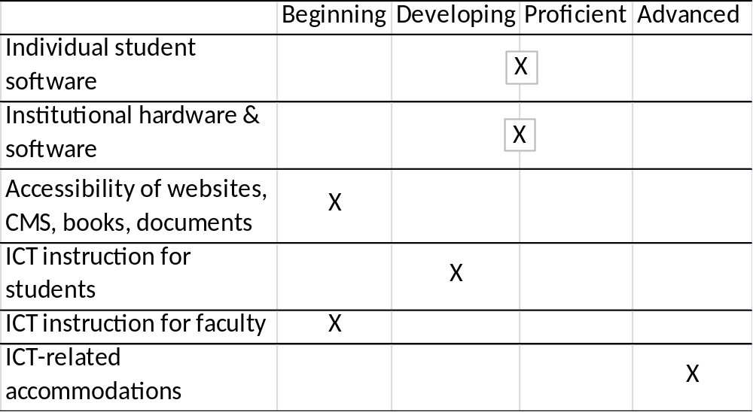
How are we doing?
Notes:
Survey audience re their job/position. + Explain Cegep.

Slide 7
Barriers to Supporting and Delivering ICTs
Weak legislation and enforcement
Lack of top-down institutional support
Responsibility for inclusion remains with disability services
Insufficient knowledge re production of accessible websites, documents etc.

Slide 8
Contact Us
Adaptech Research Network
  www.adaptech.org
Alice Havel
  ahavel@dawsoncollege.qc.ca
  Catherine Fichten
  cfichten@dawsoncollege.qc.ca
  Laura King
  laura.king@claurendeau.qc.ca

