Slide 1
STUDENT PANEL 1: Sharing our current experience of using technology to support our learning
Marilin Salström, Cherry Day, Ron Turner, Billy D & Sheila Cameron
with Tim Coughlan, Chetz Colwell and Jane Seale
Notes:
Inroduction
Introduction- 10 minutes- Tim?
Marilin- 5 minutes- supported by Chetz
Cherry- 5 minutes
Ron- 5 minutes
Billy (as shared by Sheila)- 5 mins
Sheila- 5 mins
Summary- 5 mins- Tim
Discussion and Questions from the audience- 15-20 minutes

Slide 2
1. INTRODUCTION

Slide 3
Background to the OU
Mission to be open (no entry requirements) and offers flexible study
Attractive to disabled students
OU’s Annual report (2018) indicates that there are over 24,000 students with declared disabilities enrolled at the OU- approx. 18.5% of the total population

Slide 4
Background to how we captured the ICT experiences of disabled students at the OU to share with you today
Jane, Tim and Chetz worked with Sheila Cameron of the Disabled Students Group to plan three events:
Facebook Event (how many students took part?)
Adobe Connect Meeting ( 1 or 2 students)
Face to face workshop (5 students)

Slide 5
Broad themes that emerged (1)
Access
Availability of technology
Cost of technology
Accessibility
The need to use technology to make courses and studying more accessible
The need to make some electronic resources accessible

Slide 6
Broad themes that emerged (2)
Support
From OU services and tutors
From other students
Methods of sharing information and resources
Inclusivity
Some learning activities such as ‘collaborative learning’ are difficult for disabled students to participate in
Disability awareness raising

Slide 7
2. SOME INDIVIDUAL EXPERIENCES

Slide 8
Marilin Salström: My vision for moving from a non-inclusive society to an inclusive society
Notes:
1. Picture on the left- a steep stair case leading to a stage -representing an non-inclusive society.
Some disabled students get to the top of the stair case and they are happy in their hats on the stage
Other disabled students want to get on the stage but they cant- some get stuck on the stairs, others actually fall off. For example, wheel-chair users and students with invisible disabilities.
2. Picture on the right- my vision of an inclusive society- a long shallow ramp.
Marilin- do you want to make some links to technology- what is it about technology that means sometimes you are on a long shallow ramp and sometimes you are falling down the steep stairs?

Slide 9
Cherry Day: Technology has played a big role in my whole life, not just study

Slide 10
Ron Turner
Costs
Some students are not entitled to DSA
Tech can make a difference, but some of it is out of reach and unaffordable
Training to use tech costs money
Some expensive tech does not get used
Free trials of software can help
Support
OU provides some e.g. through the library, but there are still times when students drop out because they are overwhelmed by the tech + learning
It can take too long to get alternative formats of materials which can put a student behind causing them to have to defer
The process for getting tech and assessment is long and slow

Slide 11
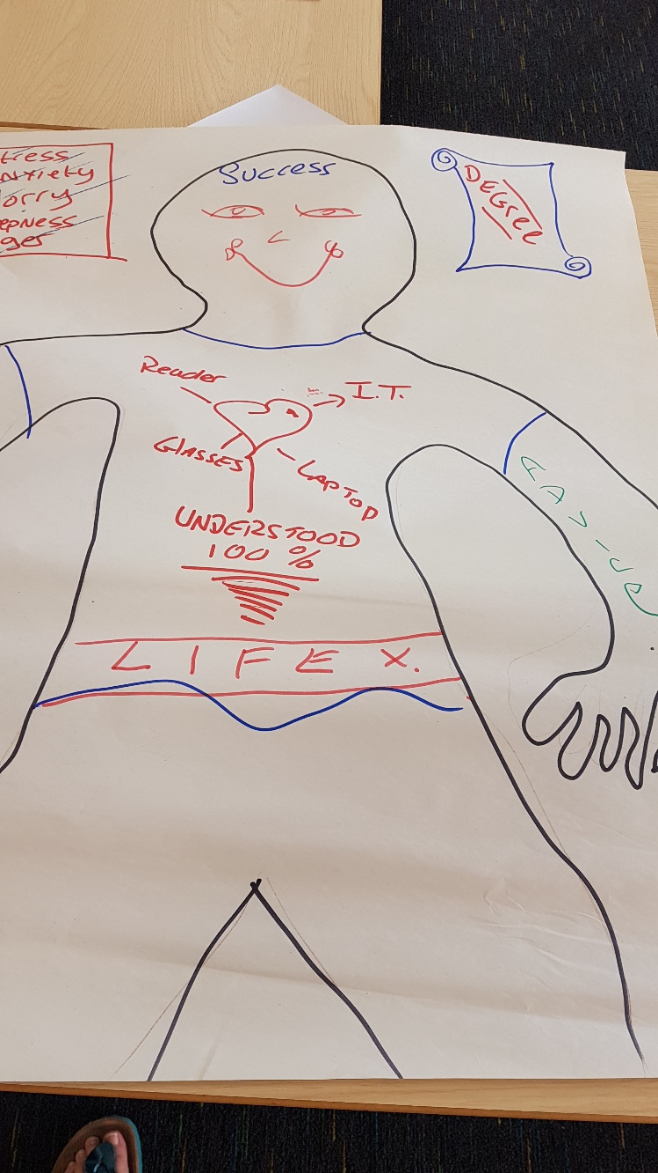
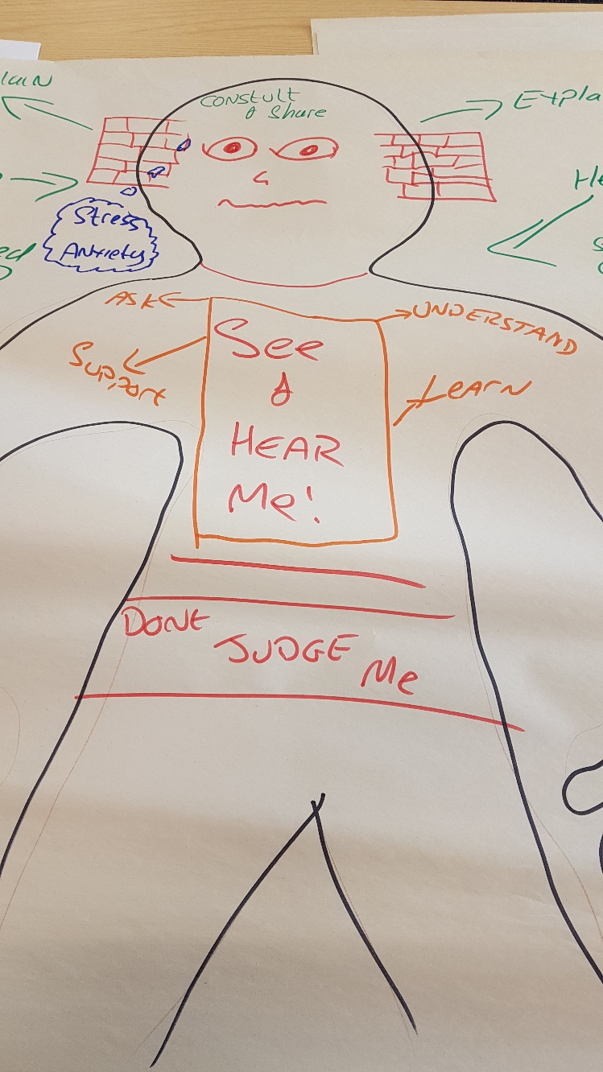
Billy D: My vision of an ideal experience
Notes:
Picture 1 on the far left- My current experience of using technology
Picture 2 in the middle- what I would like my experience to be
Picture 3- what I think needs to happen for my ideal experience to become a reality

Slide 12
Sheila Cameron: the good bits and the bad bits of technology

Slide 13
Summary
Wide range of technologies play a role in our lives
Technology doesn’t just impact on our study, it impacts on our whole life- which is why when things aren’t perfect like cost or support or awareness and attitudes, the outcomes for us can be so negative
But when things are great, they are great….

Slide 14
3. QUESTIONS AND DISCUSSION

Slide 15
4. BREAK
Come back at 3.00 for a Research focused birds of a feather exercise led by Chetz Colwell and Jane Seale

