Slide 1
Involving disabled students in research
Kate Lister, IET, The Open University

Slide 2
Themes
Trajectory
Technologies
Methods
Participation
Implications

Slide 3
Agenda for research
We co-designed and ran an event with students to build a participatory research agenda
Facebook post
Facebook event (5 days)
Workshop (face-to-face and live-streamed)
Research agenda

Slide 4
Agenda for research: themes
Social/leisure activities, connecting with community
Disclosure: fear, necessity, hidden disabilities
Access to information, not knowing or understanding rights
Reasonable adjustments: importance, flexibility, processes
Non-medical help (NMH): flexibility, processes
Stigma around mental health conditions
Administrative processes: burdens and impacts
Language used to describe disability
Research agenda

Slide 5
Administrative burden
We explored one of the themes students raised: administrative burden
Consulted with students
Captured narratives
Co-designed a survey
Research agenda
Explore a theme

Slide 6
Administrative burden
Results:
Diversity of challenges/experiences
Impacts on stress/wellbeing
Impacts on user’s impression of institution/organisation
Importance of the impacts/challenges being visible to the institution /organisation
Research agenda
Explore a theme

Slide 7
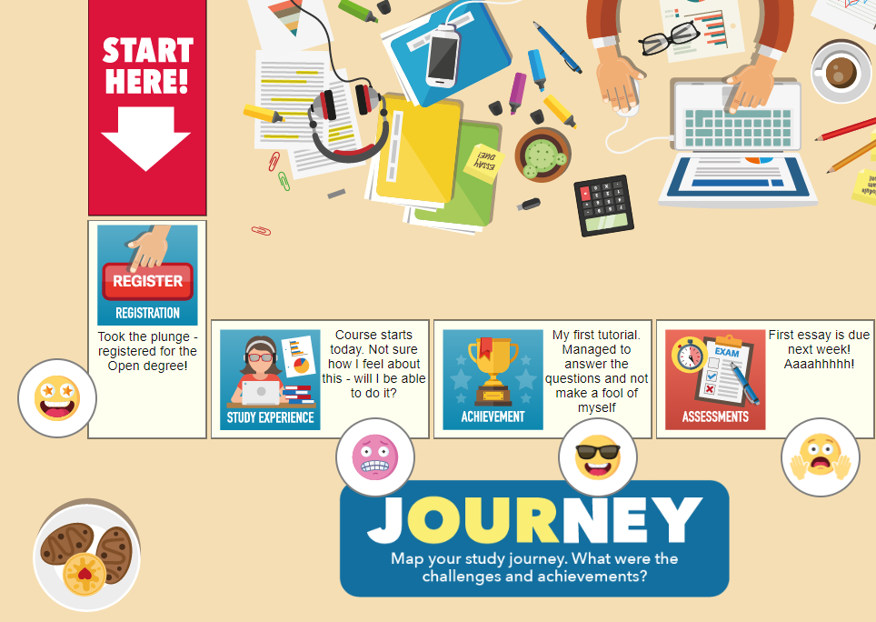
Our Journey
Co-designed the Our Journey tool to support students to share their journeys
Workshops
Print version
Online version using Javascript
Research agenda
Explore a theme
Design an intervention

Slide 8
Mental health in distance learning
Trialling the tool in a study investigating impacts of distance learning on mental health
Interviews and focus groups
Our Journey as narrative capture
Vignettes
Research agenda
Explore a theme
Design an intervention
Apply the intervention

Slide 9
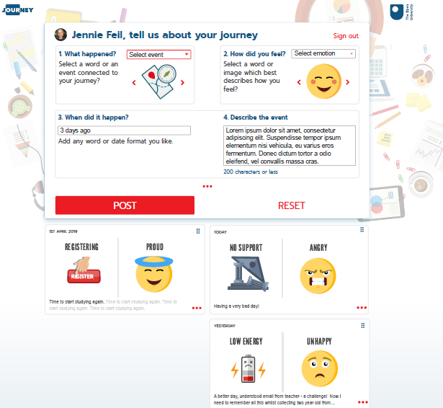
Linked Journeys
Further developing the Our Journey tool
Design workshop with students
Sprint sessions with tech team
Iterative dev testing with students
Using Laravel and Vue.js
Research agenda
Explore a theme
Design an intervention
Apply the intervention
Improve the intervention

Slide 10
Implications
Our Journey tool is open source and flexible, can be used to support reflection or capture experiences
Participatory approaches to research design were effective and appreciated
Importance of student choice in engagement, method of communication

