Slide 1
An investigation into the accessibility of Massive Open Online Courses (MOOCs)
Francisco Iniesto
Institute of Educational Technology
Supervisors: Patrick McAndrew, Shailey Minocha and Tim Coughlan
francisco.Iniesto@open.ac.uk
ED-ICT International Network – UK Conference 11-12 June 2019

Slide 2
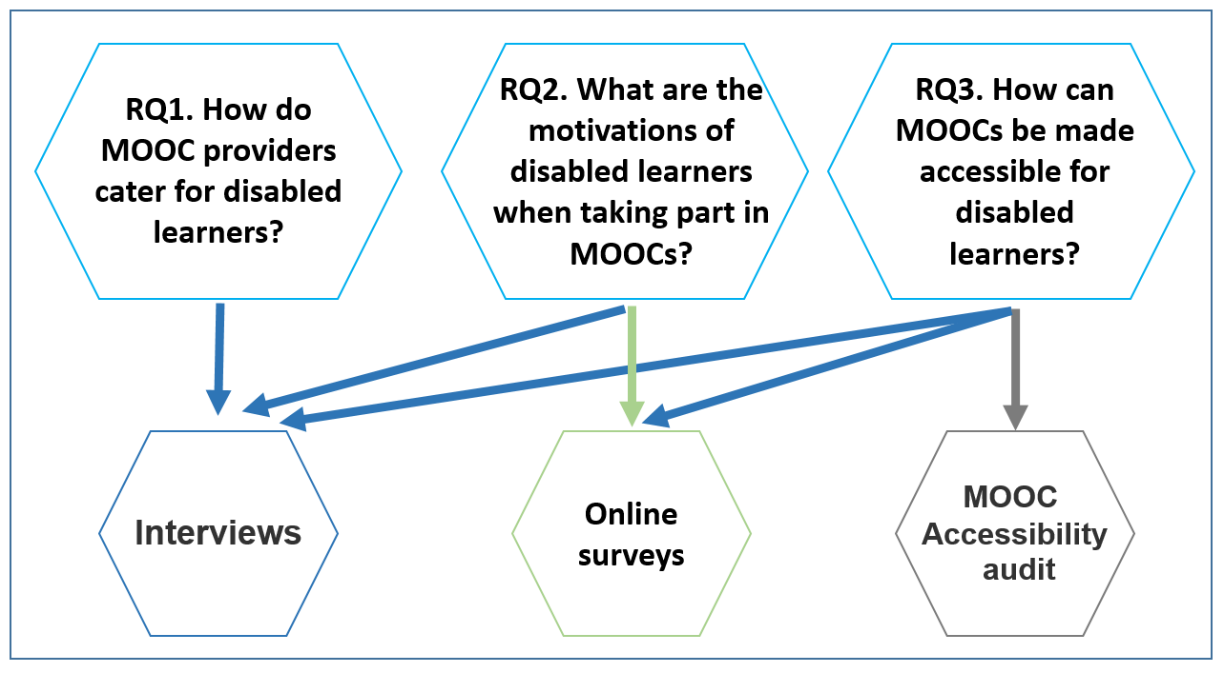
Research questions
RQ3 a. What is the current state of accessibility of MOOCs?
RQ3b. How can accessibility issues in MOOCs be identified and addressed?

Slide 3
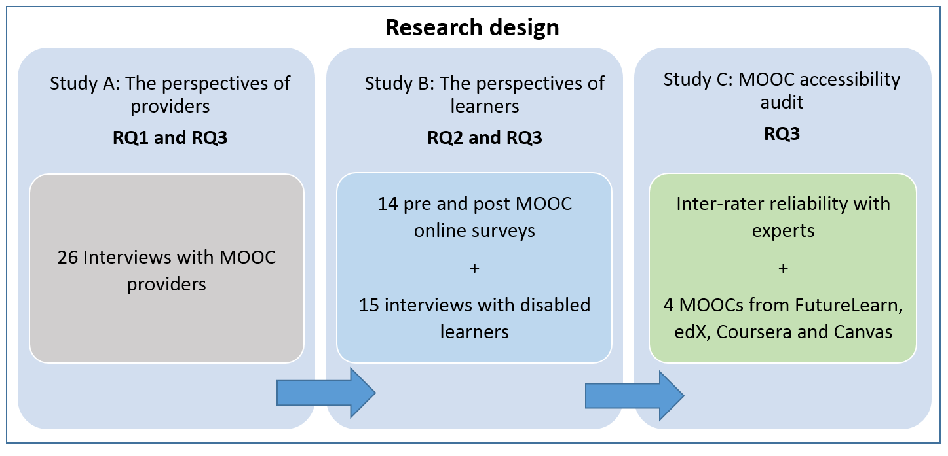
Research Design

Slide 4
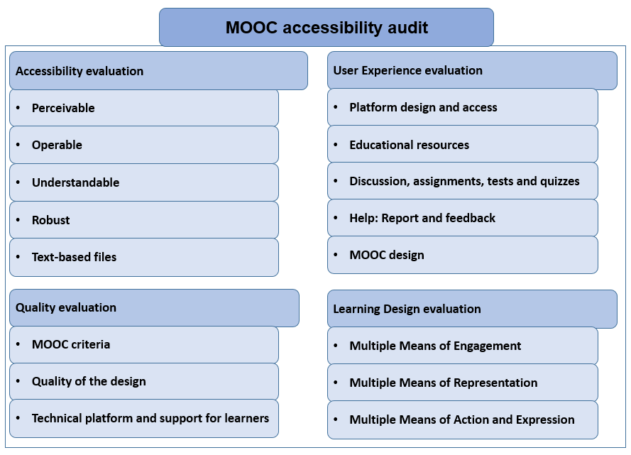
Research Design

Slide 5
Contributions to knowledge
RQ1. How do MOOC providers cater for disabled learners?
There is a lack of data on disability in MOOCs
Providers think MOOCs can be helpful for disabled learners.
MOOC platforms depend on legislation, and it is driving accessibility
Find help and report accessibility
RQ2. What are the motivations of disabled learners when taking part in MOOCs?
Interest in the educational subjects, flexibility, friendly environment, low cost, personal and Professional Development
RQ3. How can MOOCs be made accessible for disabled learners?
Barriers are not necessarily related to technical aspects or disabilities, there is scope for improvement in accessibility
Limitations of MOOC production to provide dynamic solutions to accessibility barriers, learners responses to barriers are far from the solutions they will like to find

Slide 6
Implications, limitations and future research
This research has two implications derived from its findings:
Greater knowledge of the MOOC stakeholders in accessibility
MOOC Accessibility Audit and recommendations
This research benefits MOOC providers and learners
Limitations: Representativeness
Future research:
Future work in empirical research and in the audit
Conclusions
MOOC providers need a better understanding of their learners and their needs
Accessible MOOC development: Inclusive Design approach

Slide 7
An investigation into the accessibility of Massive Open Online Courses (MOOCs)
Francisco Iniesto
Institute of Educational Technology
Supervisors: Patrick McAndrew, Shailey Minocha and Tim Coughlan
francisco.Iniesto@open.ac.uk
ED-ICT International Network – UK Conference 11-12 June 2019

