Slide 1

Digital accessibility challenges, and implications for Higher Education
David Sloan
UX Research Lead
www.wikihow.com/Walk-With-a-Blind-Person

Slide 2

Introduction
Image credit: Flickr user Caroline Davis 2020
Notes:
My background Dundee University: Space systems and inclusive design
Accessibility and space exploration: An opportunity to explore and enable; but also a concern when we head somewhere new and leave people behind

Slide 3

What challenges do we face?

Slide 4
Current challenges to digital accessibility
Education and awareness
Compliance culture
Organizational/strategy
Notes:
Credit to my colleagues at TPG who, as people working at the coalface of accessibility, are ideally placed to share current challenges and emerging threats to digital accessibility.

Slide 5

Education: Using WCAG is hard
Least usable WCAG 2.0 Success Criteria (Silver Task Force research):
  SC 3.3.4 Error Prevention (Legal, Financial, Data)
  SC 3.2.2 On Input
  SC 4.1.1 Parsing
  SC 4.1.2 Name, Role, Value
  SC 1.3.3 Sensory Characteristics
Notes:
From a survey conducted in Autumn 2017, 148 complete responses.
Usability broken down into learnability, memorability and teachability.
Differences in answer based on role and years’ experience in accessibility.

Slide 6

Education
Lack of awareness of how people with disabilities use digital resources
Lack of understanding of core technologies (HTML!)
Lack of tested, reliable design patterns
Image credit: saibotregeel
https://www.flickr.com/photos/61212260@N00/524048716

Slide 7

Compliance culture
”What do we need to do to comply?”
Audits as bug lists
Accessibility treated as a discrete project
Image credit: captaincinema
https://www.flickr.com/photos/72952415@N00/3945492506

Slide 8

Organizational strategy
The “Accessibility Lorax”
Staff turnover
Outsourced development, outsourced content… outsourced accessibility
The Lorax
Dr Seuss Enterprises

Slide 9
Emerging concerns for accessibility
The effect of drive-by lawsuits on laws and standards
Authoring tools and practices
Kiosks and touch screens
Virtual and augmented reality

Slide 10
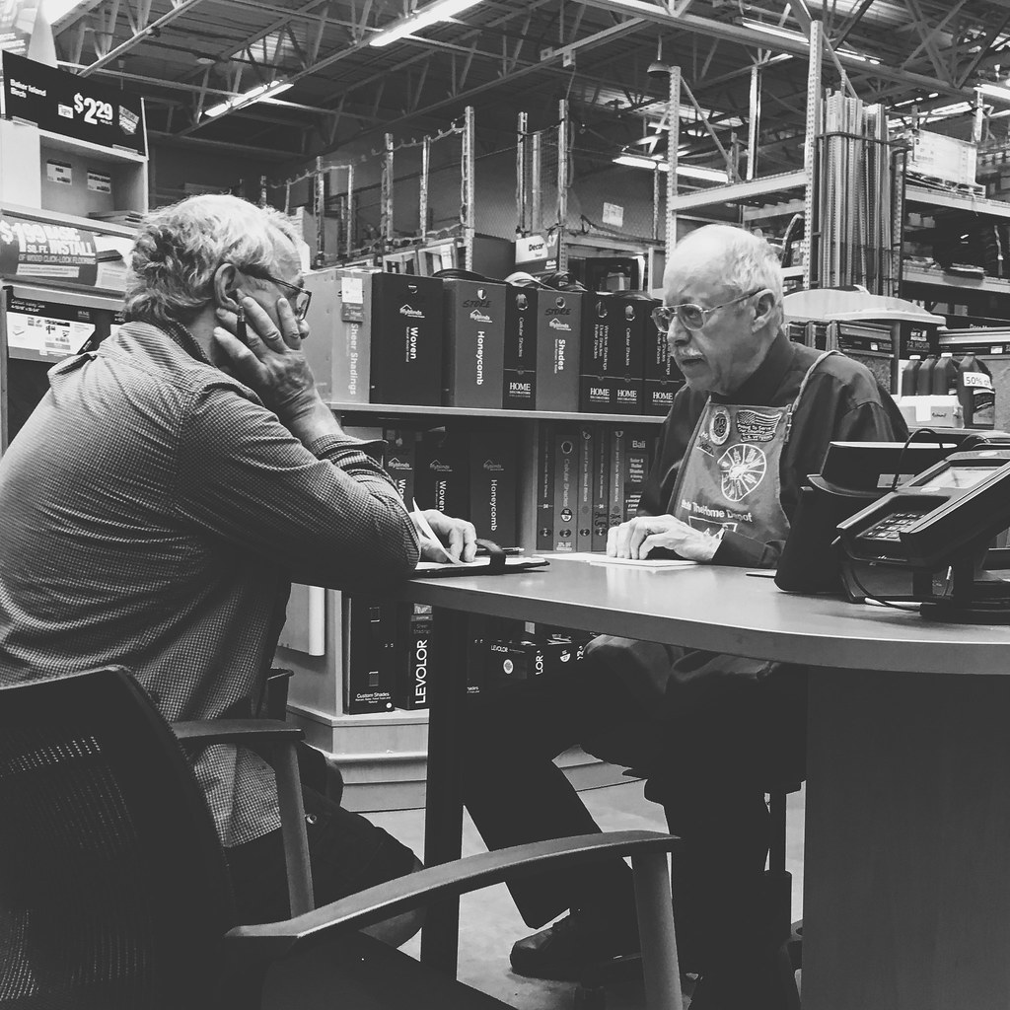
Law and standards
Focus on bare-minimum compliance or financial settlement
Watering down of what is mandated—output over process
Can current process standards reach beyond the public sector?
Image credit: MASH-8-2
https://www.flickr.com/photos/151177098@N03/37161826966

Slide 11
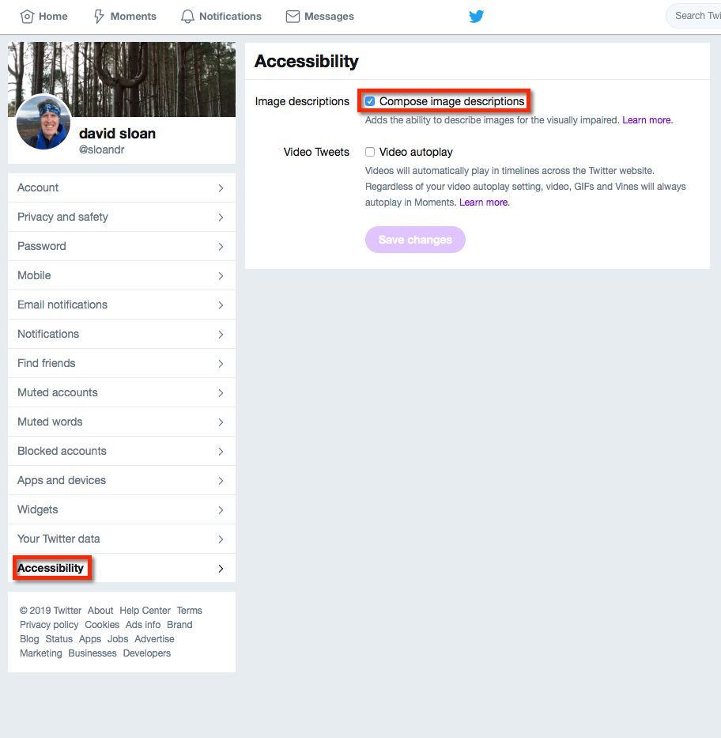
Authoring tools and practices
”the multimedia-fication of social media”
Website-in-a-box solutions
Wordpress Gutenberg
Google Accelerated Mobile Pages (AMP)

Slide 12
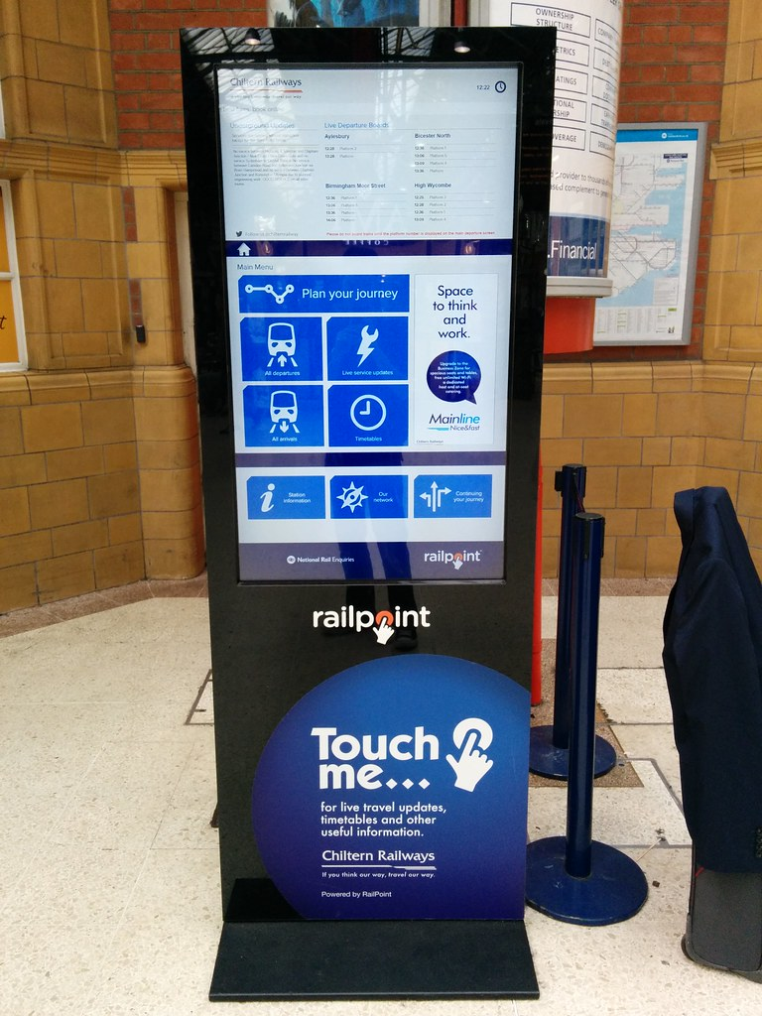
Touchscreen interfaces
Public access terminals
Consumer electronics
Vehicles
“Internet of things” enabled devices?
Image credit: Stephen Cannon
https://www.flickr.com/photos/68842060@N00/15125053080

Slide 13
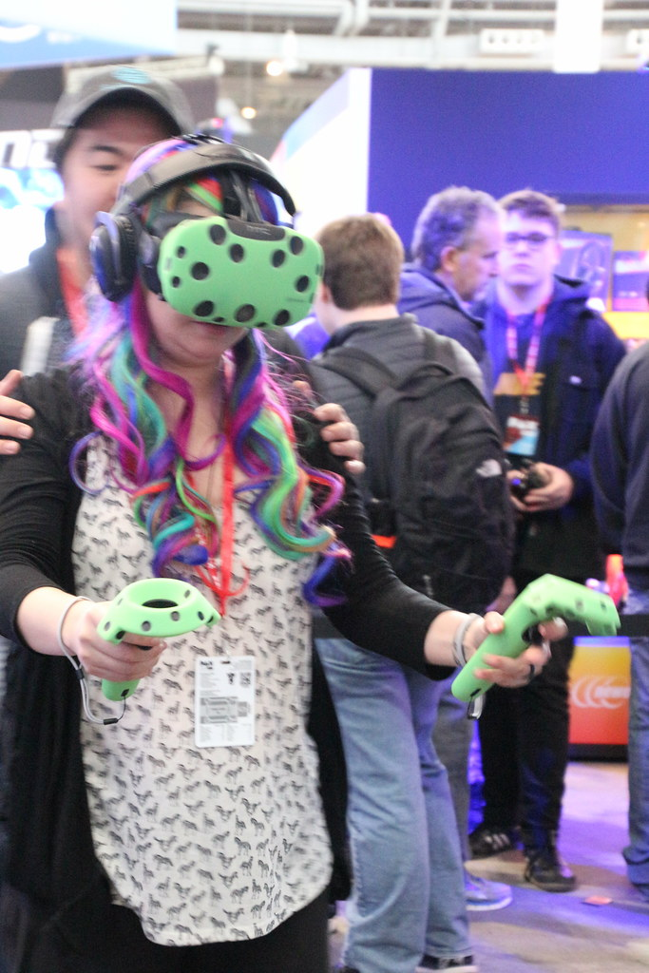
Virtual and augmented reality
Changing our reality and the ways in which we interact with that changed reality
Are these new interfaces accessible?
Image credit: arcticpenguin
https://www.flickr.com/photos/72512129@N00/36629207680

Slide 14
How can Higher Education help?

Slide 15
Accessible Design Maturity Continuum
Notes:
The accessible design maturity continuum. What can Higher Ed do to help organisations move along the continuum?

Slide 16
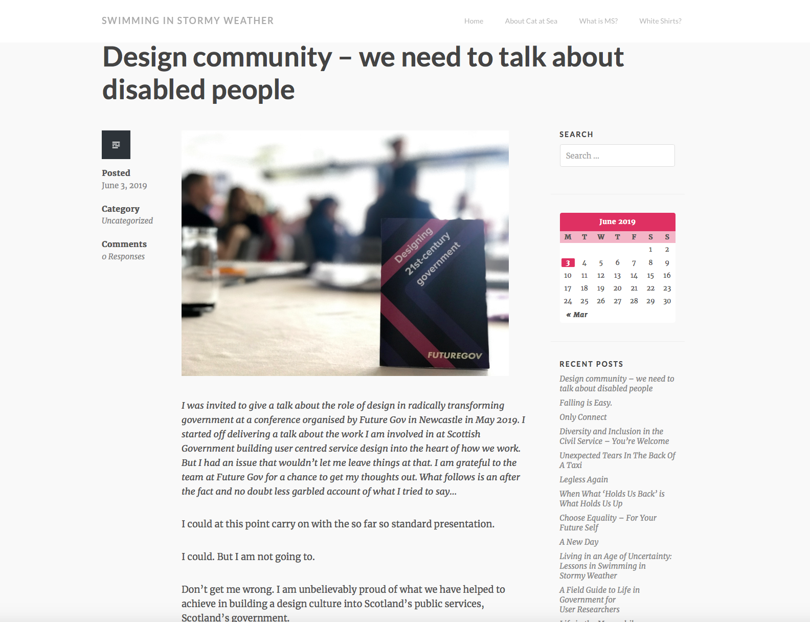

Slide 17
Higher Education action points
Teaching
  Help tackle (dis)ablism in technology
  Integrate accessibility into the curriculum…everywhere!
  Get involved in or replicate Teach Access

Slide 18
Higher Education action points
Data:
  Generate and share evidence to support the value of accessibility
  Publish tested, validated design patterns
  Promote inclusive research and design methods

Slide 19
Higher Education action points
Innovation:
  Ensure accessibility is an ethical consideration in new discoveries
  Get involved in standards development, not just accessibility standards

Slide 20
We have plenty of work to do!
Email: dsloan@paciellogroup.com
Twitter: @sloandr

