Slide 1
Where is Technology going in Higher Education?
E.A. Draffan

Slide 2
What’s in and What’s out?
ALT and UCISA 2018 surveys
CMS & VLEs
Blended Learning
Electronic assessment
Lecture Capture
Assistive Technologies
ePortfolios
‘MOOCs, SPOCs and TOOCs’.
Notes:
‘MOOCs, SPOCs and TOOCs’.
Massive Open Online Courses
Small Private Online Course
Targeted Open Online Course
http://repository.alt.ac.uk/2431/2/ReportingfromtheAnnualSurvey2018.pdf
“Looking ahead to future priorities ‘Content Management Systems and VLEs’ and ‘Electronic assessment’ remain the top two future priorities. Ranked third in terms of future importance is ‘Blended learning’. When comparing responses to last year’s survey ‘ePortfolios’ and ‘Assistive technology’ have seen the greatest increases in importance for future practice. The area which has seen the biggest decrease in future importance is ‘MOOCs, SPOCs and TOOCs’. “

Slide 3
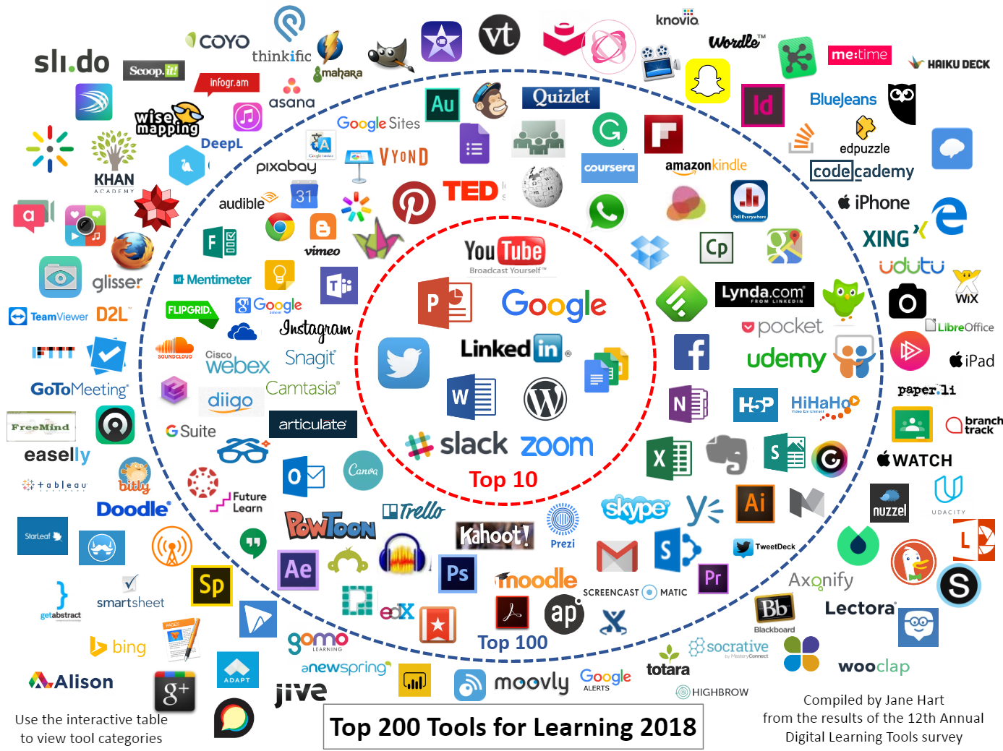
Top Tools for Learning 2018
Notes:
https://www.toptools4learning.com/home/
Top Ten
YouTube
Powerpoint
Google Search
Twitter
LinkedIn
Google Docs & Drive
Word
WordPress
Slack
Zoom

Slide 4
Significant Challenges to ICT Adoption in Higher Education
Horizon 2019 Higher Ed Report…
Solvable Challenges:
Improving Digital Fluency
Increasing Demand for Digital Learning Experience and Instructional Design Expertise
Difficult Challenges:
The Evolving Roles of Faculty with Ed Tech Strategies
Achievement Gap
Wicked Challenges:
Advancing Digital Equity
Rethinking the Practice of Teaching
Notes:
https://library.educause.edu/resources/2019/4/2019-horizon-report

Slide 5
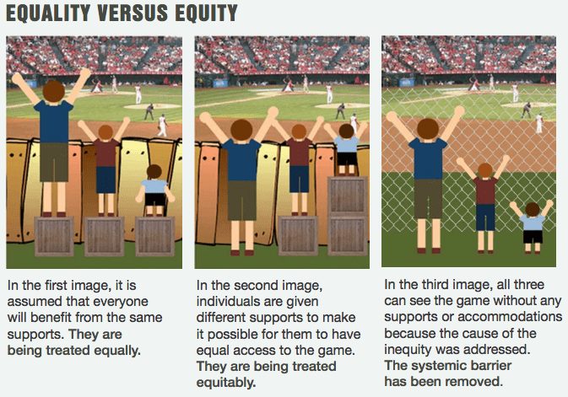
Expanding Access and Equity
“People expect to be able to learn and work anywhere, with constant access to learning materials, as well as each other” (Horizon panel 2019)
Courtesy Advancing Equity and Inclusion: A guide for municipalities (CAWI Ottawa),
Notes:
A picture illustrating the concepts of equality, equity and justice.
Courtesy Advancing Equity and Inclusion: A guide for municipalities, City for All Women Initiative (CAWI), Ottawa

Slide 6
Real life Experiences
Society for Research in Higher Education -Universal Design for Learning. Health Warning sweeping statements…
Students from widening participation (WP) institutions tended to focus on access to staff time. Staff revealed a strong commitment to facilitating student success through e.g., reliable use of virtual learning environments and allowing lecture recording.
Russell Group students were more interested in interventions to lighten heavy workloads, such as prioritised reading lists. Staff were not all enthusiastic about having their lectures recorded.

Slide 7
Time to Adoption - Horizon
1 yr or less
Mobile Learning
Analytics Technology
2-3 years
Mixed Reality
Artificial Intelligence
3-4 years
Blockchain
Artificial Assistants
Notes:
1 yr or less
Mobile Learning
Analytics Technology
2-3 years
Mixed Reality
Artificial Intelligence
3-4 years
Blockchain
Artificial Assistants

Slide 8
Mobile Learning
Anytime, anywhere, anyone…
Mobile micro-assessments to aid knowledge retention
Simple interactions, such as polls
Short quizzes
Augmented Reality (AR) performance support
Mentoring

Slide 9
Analytics Technology
Personalised learning: Profiles through learner interactions
Curriculum enhancement: Analysis of aggregated behaviour of learner communities
Biometrics: learners’ reactions providing actionable data to enhance learning experiences.
Biometrics will also be used for authentication in remote assessments (just a practicality)

Slide 10
Blockchain
Blockchain: Managing learning certification and accreditation - recording and registering learning actions, outcomes and performance
All short courses, seminars, conferences attended, training sessions, etc. can be recorded and matched against a set of established criteria
Digital badges and certificates can be managed through blockchain technologies, matching the learner, the activity, and the certificate.

Slide 11
Artificial Intelligence
Natural Language Processing (NLP): New forms of ‘intelligent tutoring’ e.g. chat bots supporting certain tutoring tasks and learner support.
NLP for organising and categorising documents or making better content recommendations to students and faculty as well as semantic searches so that queries can focus on the intent of the user, not literal keywords.
Grading and other administrative tasks: AI driven programs, reducing the workload of academics, making more time for research and teaching activities!

Slide 12
Educause - Most Influential Trends
Finally, a US study found ICT trends include:
“Growing complexity of security threats
Student success focus/imperatives
Data-driven decision-making
Increasing complexity of technology, architecture, and data”
Contributions of IT to institutional operational excellence

Slide 13
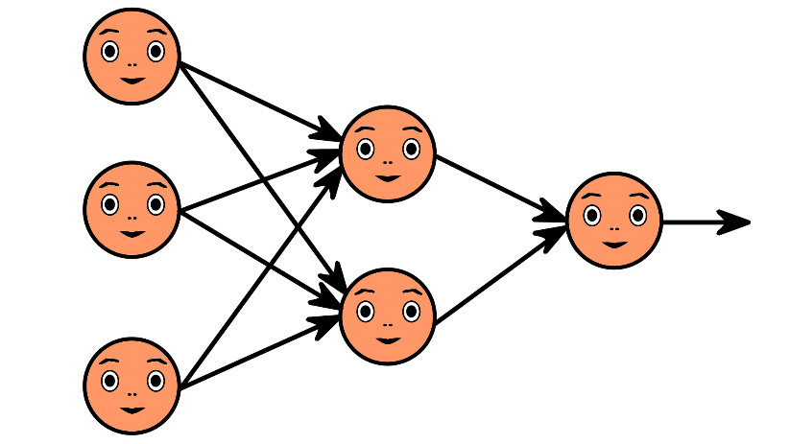
Challenges
Time…
Reaching those who may not have support to gain necessary skills
Continual Professional Development if Open Educational Resources and free Online courses fade away
Data + Machine, Deep Learning and neural networks must address bias and support inclusion

Slide 14
Back to Earth…
Thank you to Mike Wald and Manuel Leon

