Slide 1
Support for Transitions of People With Disabilities & Challenges Relating to ICT in the US
Sheryl Burgstahler, Director
Dan Comden, IT Accessibility Specialist & Access Technology Center Manager
Hadi Rangin, IT Accessibility Specialist
Accessible Technology Services, UW-IT

Slide 2
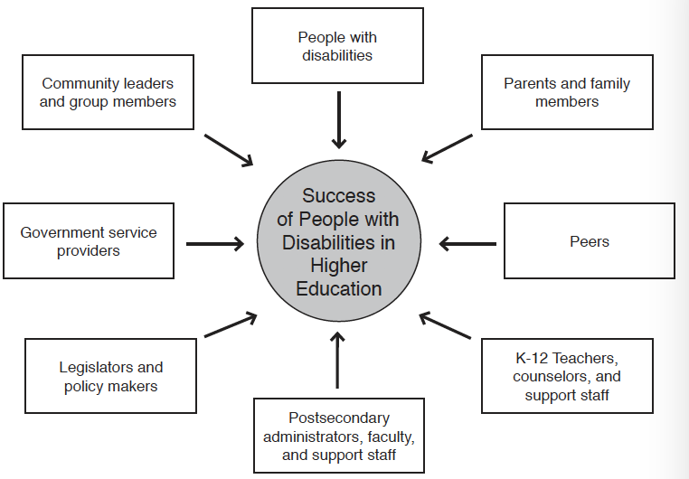

Slide 3
US federal legislation
K-12 Education | Postsecondary & Employment
Every child is offered a free, appropriate education in as integrated setting as possible; post high school transition planning is provided to some students | Students/employees must meet the entrance/course/graduation/ employment requirements with or without reasonable accommoda-tions that they must request
Section 504 of the Rehabilitation Act of 1973 The Americans with Disabilities Act of 1990 & its 2008 Amendments • Individuals with Disabilities Education Act (IDEA) | Section 504 of the Rehabilitation Act of 1973 The Americans with Disabilities Act of 1990 & its 2008 Amendments

Slide 4
Transition challenges:
diminished support systems after high school
little access to successful role models
inadequate self-advocacy skills
lack of or ineffective accommodations
low expectations on the part of people with whom they interact & …

Slide 5
…inadequate access to ICT—mainstream & assistive technology (AT)—that could increase:
education
careers
family life
community
recreation
independence
productivity
participation
in

Slide 6
ICT Challenges, 1/2
Support takes place at specific institutions; there are exemplary practices, (e.g., DO-IT) but no nationwide coordinated effort to address transition issues.
Most efforts are for securing AT for individuals, not on universal/inclusive design of mainstream ICT.

Slide 7
ICT Challenges, 2/2
There is not adequate training & support for stakeholders.
Funding for AT & other ICT varies—at school, at home, at work

Slide 8
Feedback from students
My school doesn’t provide AT.
I can’t take the school’s AT home.
AT prices are high.
Often AT does not integrate well with mainstream ICT.
Websites, videos, PDFs are often inaccessible

Slide 9
Exemplary ICT practices
Undertake efforts that are student-centered & promote self advocacy/determination
Engage stakeholders
Promote accessibility within context of UD, social justice, & inclusive culture
Work proactively & reactively
Work bottom-up & top-down
Build ICT policy, guidelines, procedures, & support that addresses transition issues

Slide 10
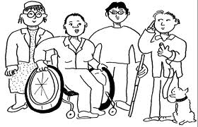
Conclusion
Employees & students at all levels should have access to the AT & support they need.
All ICT should be accessible to people with disabilities

