Slide 1
Approaches to integrating technologies into the disabled student experience at The Open University UK
Tim Coughlan
Chetz Colwell
Jane Seale

Slide 2
What the Open University UK does
Our mission is:
To be open to people, places, methods and ideas
To provide high-quality university education to all who wish to realise their ambitions and fulfil their potential
Supported Open Learning model:
Team-based course production process (materials, activities, assessments)
Students assigned to small tutor groups (7-20) for support and interaction
Learning at scale: 175,000 students. 3,000+ on some course presentations.
22,598 active students with declared disabilities (1st Feb 2018).

Slide 3
Deploying generic technologies
Accessibility considerations in procurement processes are key
Accessibility testing
Moodle VLE:
OU UK has had a key role in the development of this platform which is core in our teaching. We have evaluated and contributed plugins and fixes for accessibility.
Adobe Connect
Accessibility testing led to problems identified: Blind users are unlikely to be able to set up the software themselves. Guidance issued to staff and students.
Notes:
An important area for focus are the processes we use to choose and deploy technologies for use by all students.
Accessibility issues are evaluated as part of technology procurement. This can be in competition with other priorities but it is a key consideration.
We conduct accessibility testing of tools that we deploy with our students, or of major updates to tools.
A couple of examples:
-OU UK has been extensively involved with the development of Moodle. An open source VLE. As part of this we conducted a major evaluation of the accessibility of Moodle in 2007-08. We have contributed a range of fixes to the core platform, including a more accessible Forum tool. We continue to develop the accessibility of our own instance of the platform.
-A more recent example is Adobe Connect, which replaced our previous tool for online tutorials. Accessibility testing identified a range of issues, including access for blind users and users that require specific colours. In this case, accessibility guidance has been issued to staff and students, and continue to work with Adobe on accessibility.

Slide 4
Deploying technologies to support the disabled student population
SensusAccess
Automatically converts documents into alternative media including audio, ebook and digital braille.
Aimed at students doing independent research who need to read materials beyond standard course texts.
Pilot provision for print disabled students by the OU Library
Notes:
Where appropriate, we also deploy some technologies specifically to help students with specific needs. One recent example has been SensusAccess.
For course texts and in the case of materials that are required reading for a course, the OU would provide alternative formats. However there is an issue where students are expected to do independent reading or research, for example in a project module or literature review. For this reason, we are piloting the use of SensusAccess. This software is available to students to automatically convert documents into formats that are more useful to them.

Slide 5
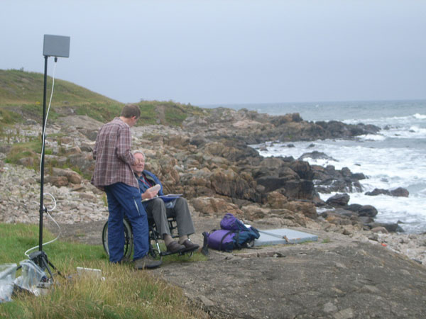
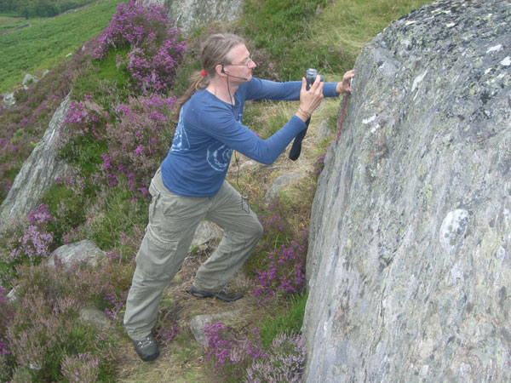
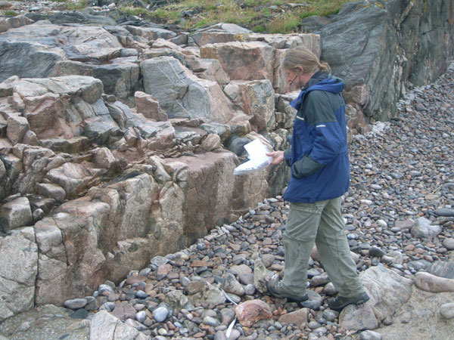
Research in Practice: Enabling Remote Activity
Notes:
The Enabling Remote Activity (ERA) project provides opportunities for mobility impaired students to fully participate in fieldwork learning activities.
Students are taught investigative skills enabling them to interpret features within the landscape; establish technical skills such as sketching and the use of field equipment; and learn to collaborate with peers. Field work can be very enjoyable part of these subjects and facilitate deeper learning and understanding. However some students do not have the opportunity to participate in fieldwork. By using mobile and communications technologies ERA provides practical solutions to the challenges of fieldwork accessibility.
Residential field trips are a part of our undergraduate geoscience degrees. Some field locations are inaccessible but they can collaborate with peers who will transmit video, audio and high definition still images to them via portable networking technologies even where there is often no mobile data network.
Although ERA has developed through several externally-funded research projects, the technology has been used in modules and is available to loan for use.

Slide 6
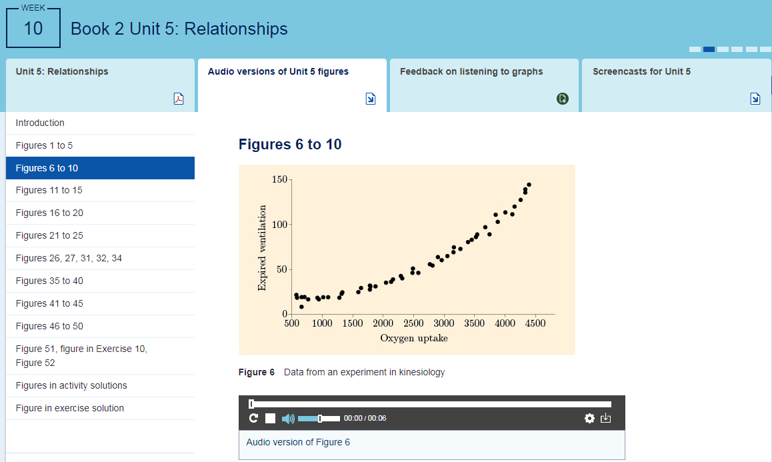
Research in Practice: Graph sonification pilot
Notes:
This project aims to explore how sonifications (a means of producing non-visual representations of graphs) can be delivered to students on a module, and the subsequent impact on students studying the module.
A unit of a module has been chosen that contains a particularly high number of graphs (more than 50) and the nature of the unit means that it has proved difficult to produce written figure descriptions that do not compromise learning objectives.
OU staff are currently evaluating this by using learning analytics to track usage of the sonifications, and also by asking the students themselves. This is in a live module and visible to all students, not just those with a declared disability.

Slide 7
Some Challenges
In distance learning the learner and their study set up is less visible.
Assessment of individual requirements for UK Disabled Student Allowances (DSA) is conducted externally. Assessors may not understand the particular needs of online and distance learning.
Agenda for increased online learning can cause problems as well as opportunities. Printed materials and face to face tutorials are essential to many of our disabled students.
Large scale means that diverse individual needs meet with an institutional desire for standardised provision.

Slide 8
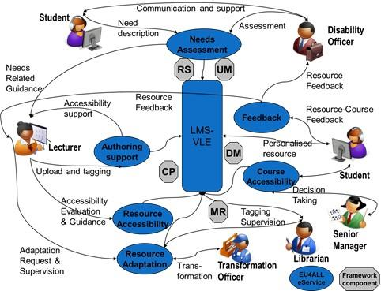
Technology is not (all of) the answer
Notes:
This diagram was an output of the EU4ALL project of which the OU UK was a partner. The project looked to develop a European unified approach for accessible lifelong learning.
This approach includes technology components alongside the VLE such as a user model (UM), a metadata repository (MR) and a content personalisation module (CP).
But what is also recognised here is that there are a large number of tasks for different stakeholders to perform that needed to be designed into the approach. It was not considered possible to automate all of these tasks and so the OU approach has been to balance digital augmentation and the human element of providing accessible services.
See McAndrew, Farrow and Cooper 2012, Adapting online learning resources for all: planning for professionalism in accessibility)

