Slide 1
Ed-ICT International Network: Students with Disabilities, ICT, Post-Compulsory Education & Employment: In Search of New Designs
Batsheva Engelberg-Behr
The Open University of ISRAEL
Computer Unit
Tel-Aviv, March 13, 2018
Notes:
ICT - Information and communications technology

Slide 2
Ed-ICT International Network, Tel-Aviv, 13-14 March 2018

Slide 3
Ed-ICT International Network, Tel-Aviv, 13-14 March 2018
Notes:
Israel - powerful country of accessibility

Slide 4
Ed-ICT International Network, Tel-Aviv, 13-14 March 2018
Ed-ICT International Network, Tel-Aviv, 13-14 March 2018
Notes:
Israel - powerful country of accessibility

Slide 5
Ed-ICT International Network, Tel-Aviv, 13-14 March 2018

Slide 6
Notes:
Ministry of Justice / Commission for equal rights of persons with disabilities
Web Content Accessibility Guidelines (WCAG) 2.0 - The World Wide Web Consortium (W3C)
ISOC – Internet society, Keeping the Internet Transparent & Open for Everyone ISRAEL
The Standards institution of ISRAEL
Council for Higher Education

Slide 7
Legislation and Standards
1998 Equal Rights for People with Disabilities – Law
2008 ISOC IL - Translation of WCAG 2.0
2013 Equal Rights for People with Disabilities – Regulation, Addition: Accessibility for Internet services
Israeli Standards*
2016 Regulations for Institutions of Higher Education
2017 Regulations, 2nd edition
2018 Israeli Standards 2nd edition + Accessibility of Digital Documents (SII)
Notes:
At the forefront of countries that promote accessibility
Mile stons (for digital accessibility).
1. Awareness in Physical aspect. Israel –war injured/hurt soldiers/people since 1948
WCAG - WEB Content Accessibility Guidelines, recommendations for making the Internet Sites more accessible
ISOC-IL Internet Association - began in 2008 integrating the subject by translating the international standard WCAG2.0 of W3C World Wide Web Consortium
Declaration – Law dealing with equal opportunity (lobby in parliament) No Idea of how to do it.
The Ministry of Justice approached the Israeli Standards Institute for the purpose of determining an Israeli standard for accessibility of Internet sites. Hebrew a problamatic Language.
Regulation 35 – in Israeli law for Equal Rights to people with disabilities
US: In 1998 the US Congress amended the Rehabilitation Act to require Federal agencies to make their electronic and information technology accessible to people with disabilities. Section 508 was enacted to eliminate barriers in information technology, to make available new opportunities for people with disabilities, and to encourage development of technologies that will help achieve these goals. The law applies to all Federal agencies when they develop, procure, maintain, or use electronic and information technology. Under Section 508, agencies must give employees with disabilities and members of the public access to information that is comparable to the access available to others.
Legislation - Adding digital documents (what)
2018 - How
2018 – Zero Conference Wien
Migdal Or is a multi-service center dedicated to advancing people with blindness or visual impairment towards independent functioning and inclusion in the workplace (60 years). Disabled towards Rehabilitation
Soon to be publishes

Slide 8
Hebrew
RTL
TTS
STT
Law (What) - Includind digital documents
SII (how) – Changes of WCAG
Notes:
At technological levels
Hebrew - problematic for accessibility
1. Direction rtl, Text to Speech
2. Punctuation (Vowelization ) נִיקוּד ספר סֶפֶר סָפַּר
3. Morphology (tell a story) סיפרתי סיפרת סיפר סיפרה סיפרנו סיפרתם סיפרו -
STT Speech to Text – exemption of time-based Media the need of creative solutions (like to the need of defence)
start-up nation mobilizer, waze, Orcam’s glasses.
Adding vocabulary to each area
____________________________________________
HCI2009, July 2009, San Diego: "How Should I Read this Word?: The Influence of Vowelization in a Deep Language Orthography on Online Text Comprehension"
________________________________________
Simplification ("It's just smart") helps understanding and remembering

Slide 9
Google Translator

Slide 10
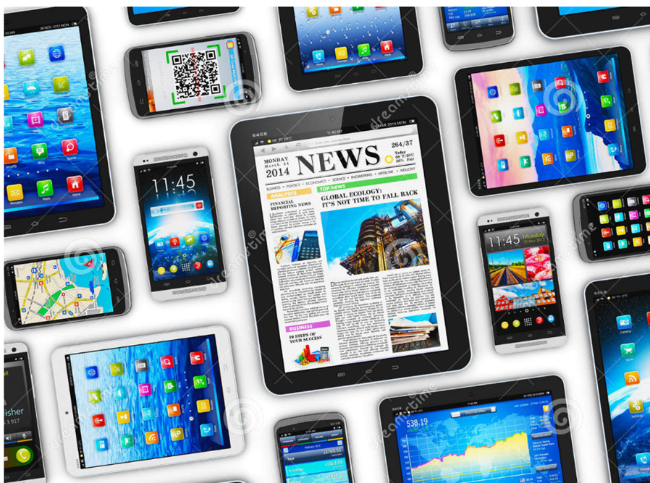
How?
Legislation
Investments
Research & Development
Ed-ICT International Network, Tel-Aviv, 13-14 March 2018
Notes:
All mobile has the platform for developing accessible applications (TTS & STT) the request for those around the world made it a standard.
No other way since the ROI on investmaent did not encourage for developing tools
Seo+ responsibility + accessibility led to the new generation of websites & applications
“ The components: legislation, return on investment, return on equity, will make an investment in R & D for additional and improved products to help disadvantaged students”

Slide 11
The Open University
Awareness
Obligation
Technics
Notes:
The Open University - At the forefront to Access to Higher Education
in home: Awarness
A special standard for institutions of higher education that requires access to information in closed sites (requiring authorization and identification) on demand (Gooly will elaborate on this).
The beginning of accessibility in 2010
The relationship between accessibility responsiveness and SEO 2015. Page structure: Emphasis and order
Infrastructure - accessibility. Information provided by many editors - the problem of assimilating the subject of building accessible documents: awareness and training
The Open University - At the forefront to Access to Higher Education
in home: Awarness
A special standard for institutions of higher education that requires access to information in closed sites (requiring authorization and identification) on demand (Gooly will elaborate on this).
The beginning of accessibility in 2010
The relationship between accessibility responsiveness and SEO 2015. Page structure: Emphasis and order
Infrastructure - accessibility. Information provided by many editors - the problem of assimilating the subject of building accessible documents: awareness and training

Slide 12
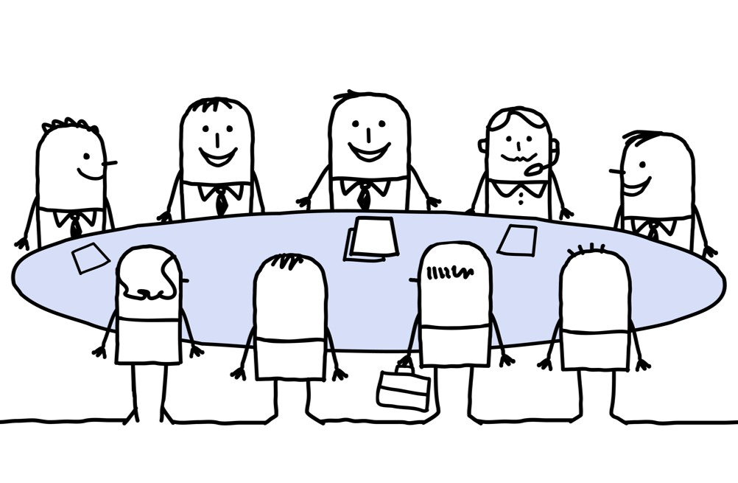
OpenU - Accessibility Forum
CEO
Dean of Students
Computer Unit
SHOHAM - Center for Technology in Distance Education

Slide 13
March 12, 2018

Slide 14
Questions?
Ed-ICT International Network, Tel-Aviv, 13-14 March 2018

Slide 15
Thanks
batsheva@openu.ac.il

